Slide 1
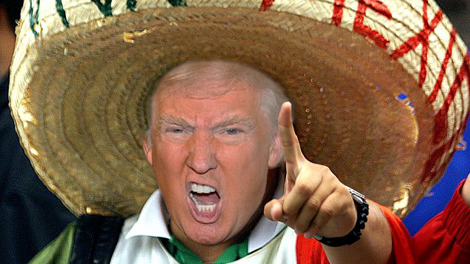
Trump’s Career as a politician
Presented by Luna Vardar, Antonin Khalife, Henry Letellier
https://i.redditmedia.com/kb6dYGfavCyyO5j9V54pBfmLIkKJJYKTIMoMxHEcVYs.png?w=634&s=ddc8b2e63077b3012fdb6edde28249f2

Slide 2
Key points
The Washington Post article
How the presidents justify:
Their previous acts
The different ways that were used to implement it
Trump:
1st president to contradict himself
How?
Affirming he didn’t spread families along the Mexican border
He had to repair Obama’s mistakes
He was the one who had gathered families together

Slide 3
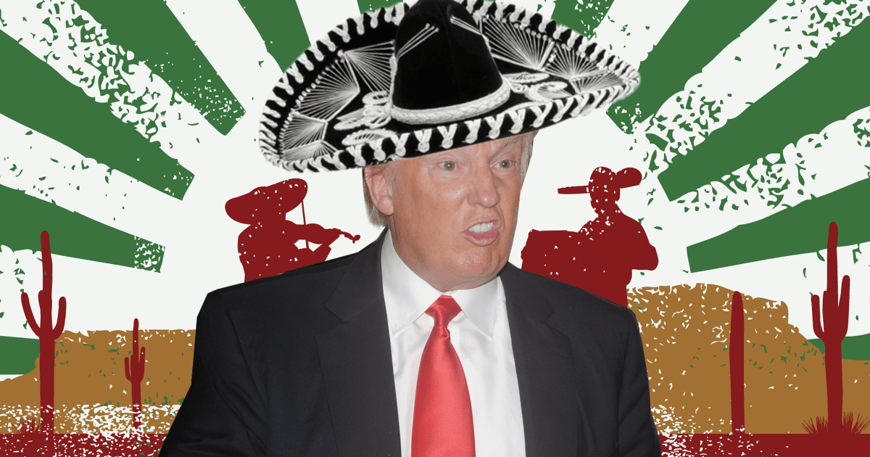

Donald Trump
Winston Smith
https://i2.wp.com/fusion.net/wp-content/uploads/2015/06/150618-trump-mexico.png?resize=1200%2C630&quality=80&strip=all
https://bluelibertyblog.files.wordpress.com/2014/06/big-brother-poster-1984.jpg

Slide 4


The same as big brother
Always blames other people
To make people think
He’s the best president and that he’s doing the right thing
Victim
Tortured, forced to believe “fake news”

